Slide 1
SURF Operations
William McElroy
Deputy Director for Operations
October 20, 2022

Slide 2
William McElroy – Deputy Director for Operations
Employed by the South Dakota Science and Technology Authority (SDSTA) for nine+ years
Project Manager (PM) for Davis Campus excavation and fit out
PM for Ross Shaft rehabilitation from inception to 3500L construction
Served as Director of Underground Access and Operations Program Manager
Currently serving as Deputy Director for Operations
Responsible for Underground/Surface Operations, Engineering, IT and QA/QC
Executive Leadership experience with public and privately funded projects, and volunteer organizations
President of Ainsworth-Benning Construction, A Journey Group company for four years
10-year contract employee for Science Applications International Corp, Raytheon & Stinger Graffarian Technologies (aerospace contractor to the U.S. Geological Survey)
Certified as a Project Management Professional (PMP)

Slide 3
Topics
Scope
Staffing
ISO Implementation
Work Planning & Execution
Computerized Maintenance Management System
Making a Shift

Slide 4
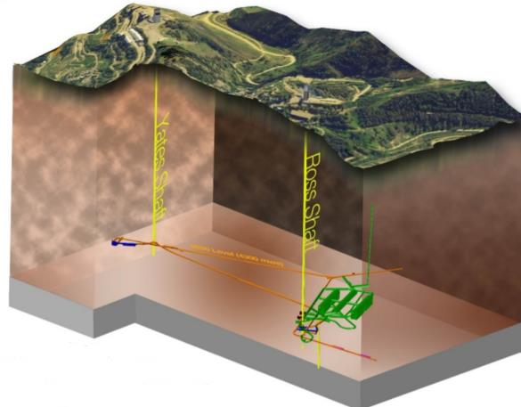
Scope - Shafts
Yates Shaft
Funded through the Cooperative Agreement (CA)
80+ year old timber shaft
Support science 4 days per week
SDSTA access
Inspect and Maintain
Top-Down Maintenance (TDM) Program
Ross Shaft
15% funded through the CA
Inspect and Maintain
Dedicated to LBNF excavation
Shaft recently rehabilitated
Only option for removing waste rock
All dewatering housed on Ross side

Slide 5
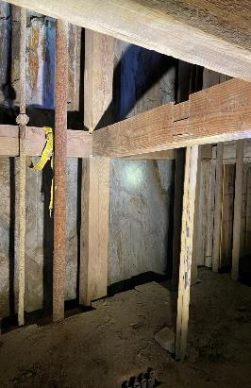
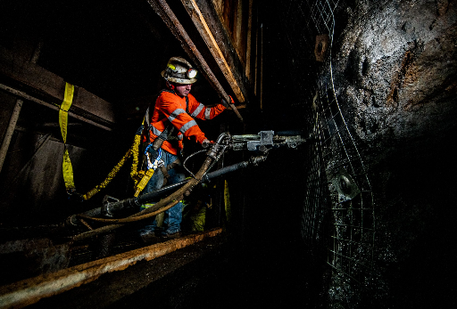
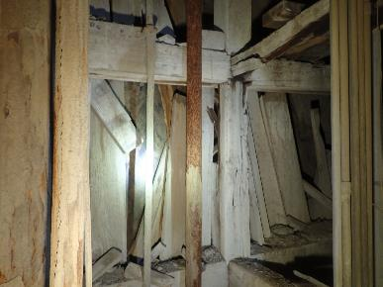
Scope - Yates Shaft
Top-Down Maintenance effort in Utility Compartment
Concentration on timber structure, removing utilities and installing ground support
July through December 2021
1850L before TDM
1850L after TDM
Infrastructure Tech installing ground control

Slide 6
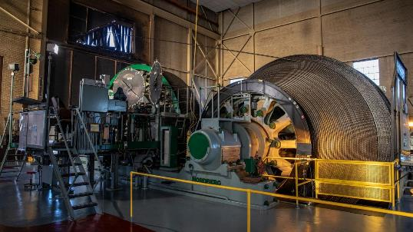
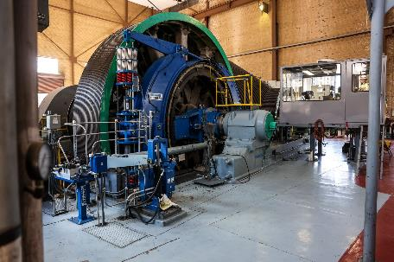
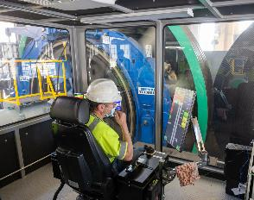
Scope - Hoists
Yates Hoisting
Funded through the CA
Support science 4 days per week
Inspect and maintain
Motor/generators have been refurbished, require TLC
Ross Hoisting
85% dedicated to LBNF excavation
All LBNF skipping
All LBNF material handing
All LBNF personnel transport
Upgraded components in 2021

Slide 7
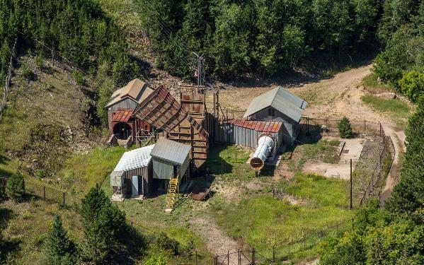
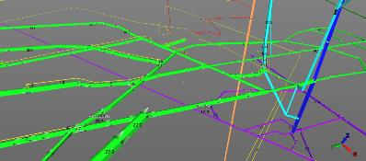
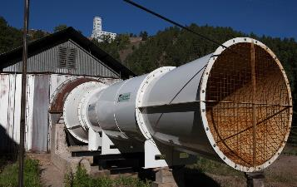
Scope - Ventilation
Oro Hondo and 5-Shaft are dedicated to providing exhaust ventilation
Underground ventilation controls are installed and maintained to adjust air flow where/when needed
Continual monitoring of underground ventilation is required and is adjusted to keep pace with changing conditions
Oro Hondo system to be upgraded this year through the IIP
Replacing auxiliary 350 HP fan to 2,000 HP

Slide 8
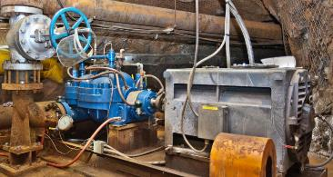
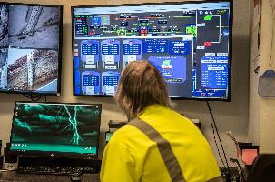
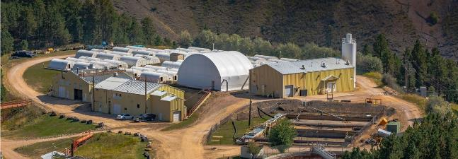
Scope - WWTP
Spares on surface
(3) 6-HMTA3 Pumps
(3) 700 HP GE Motors
1250L
(1) 6-HMTA3 Pump
(1) 700 HP GE Motor
2450L
(1) 6-HMTA3 Pump
(1) 700 HP GE Motor
3650L
(1) 6-HMTA3 Pump
(1) 700 HP GE Motor
5000L
(1) 6-HMTA3 Pump
(1) 700 HP GE Motor
6500L – Deep Well Pump
(1) Multi-Stage Pump
(1) 520 HP Motor

Slide 9
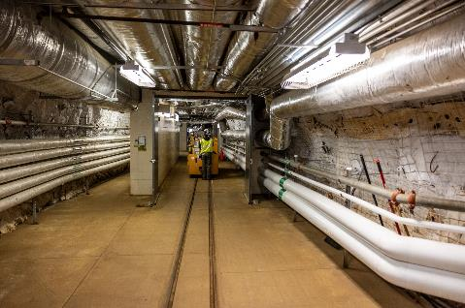
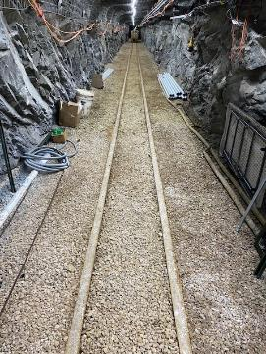
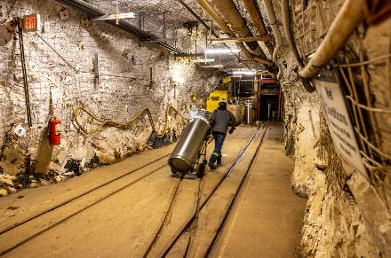
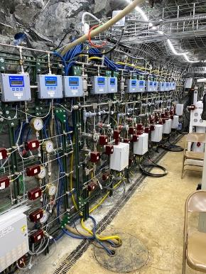
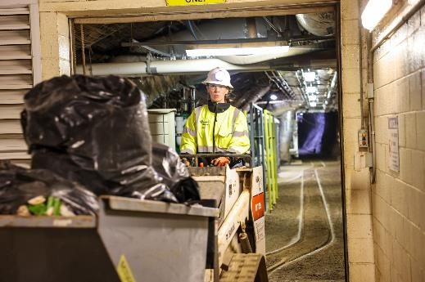
Scope – Other Support
Logistics support
Maintain access ways
Infrastructure support
IT/Comms
Waste management

Slide 10
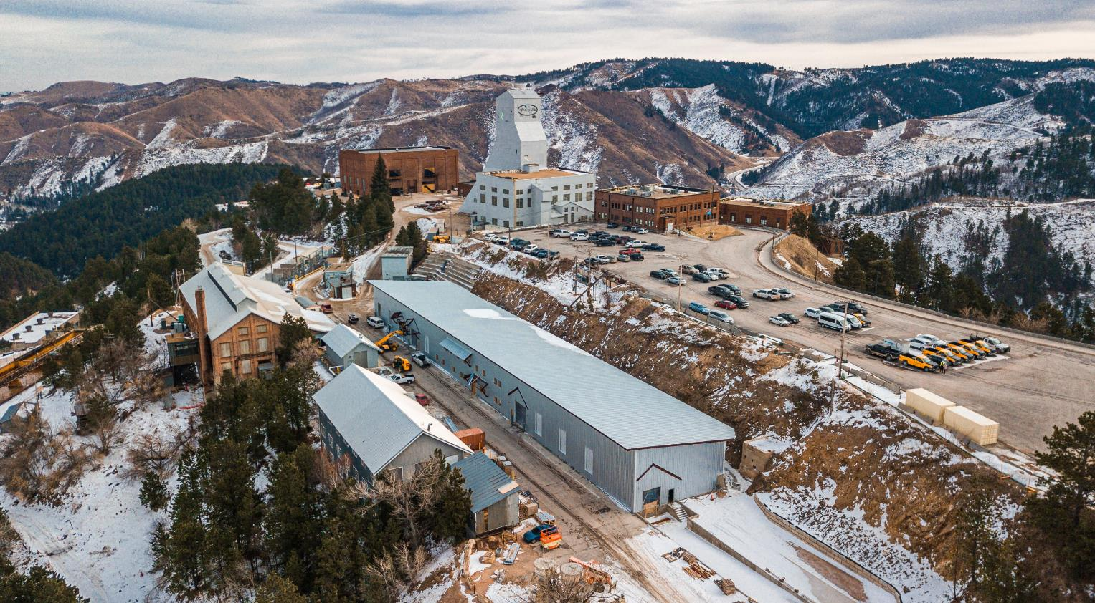
Scope – Buildings & Grounds

Slide 11
ISO Implementation
South Dakota Science and Technology Authority
Processes
Integrated Management System
International Organization for Standards
We are required to be in compliance with ISO Standards 9001, 14001 and 45001
Integrated Management System in place
Successfully passed Stage 2 ISO audit in July 2022

Slide 12
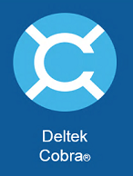
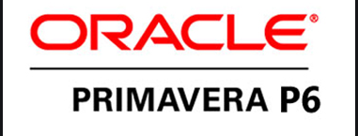
Work Planning & Execution
Fiscal budgets for Operations & Maintenance based activities are built upon the prior year’s baseline and actual costs (loaded into Cobra)
Operations Division Directors meet frequently to analyze work performed against the plan
Operations & Maintenance priorities are driven by mission need
Budgeting and scheduling maintenance of antiquated systems is a challenge, but we have experience on our side

Slide 13
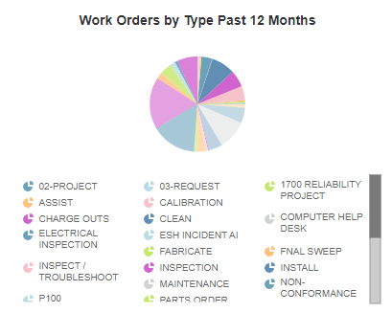
Computerized Maintenance Management System
CMMS started in 2013
Focus on Sitewide Adoption
Not Exclusively Maintenance

Slide 14
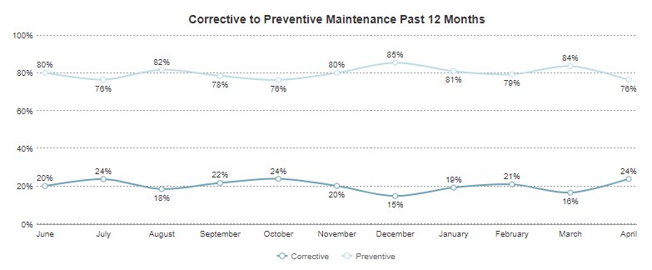
Making a Shift
Maintenance focus has been to transition from reactive to proactive
Working to correctly document assets and create preventative maintenance schedule(s) accordingly
Using corrective (reactive) maintenance vs. preventative as a metric to determine effectiveness
Notes:
We are currently managing over 1,200 assets in the software

Slide 15
Thank You
Questions?

